Slide 1
Final Project: GitHub Analysis
Joon Park

Slide 2
Executive Summary
Publicly available GitHub repository data was analyzed to determine whether or not TuringBots and other similar AI solutions would bring meaningful improvements and eventually replace software engineers and data scientists.
The analyzed dataset ranges from 2008 to 2022 (after being filtered).
Throughout the years, Shell and Python continues to be the most used programming language while languages such as C and C++ start to dwindle.
Although the committers and licenses have repositories that are related to Big-Tech companies, It is difficult to determine whether or not they are related to machine learning.
The message duplication analysis shows that that messages are still largely unique
Bottom line: Although there are some trends hinting to the question of whether or not the TuringBots will provide meaningful improvement, further data collection processes and additional measures are required to determine whether TuringBots will replace software engineers.

Slide 3

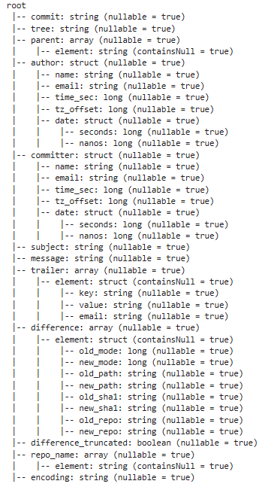

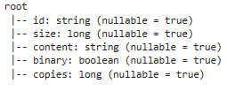
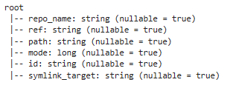
Publicly Available GitHub Repository was analyzed
- Analyzed ~1.3TB Publicly available GitHub repository data which includes:
- commits
- files
- contents
- language
- licenses
- To determine whether or not to answer the question of:
- Can these AI solutions provide meaningful improvement in developers’ productivity
- Will these AI solutions replace human software engineers and data scientists?
Language
Commit
License
File
Content

Slide 4
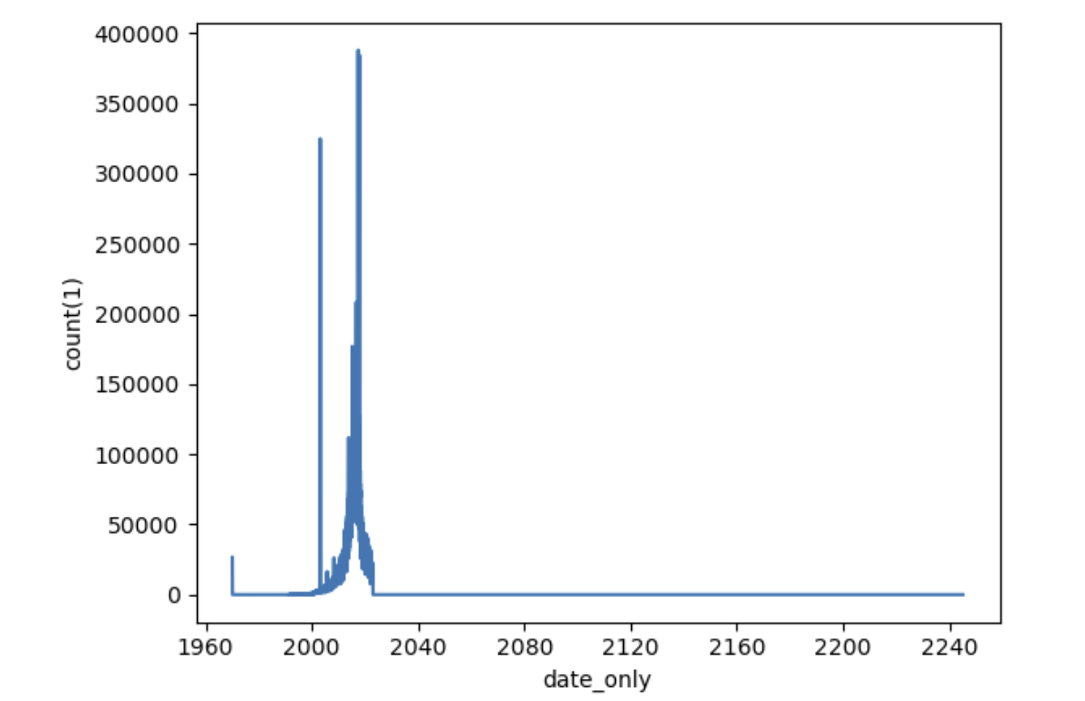
Data Cleaning and Filtering were Required to make the data less noisy
List of Data Cleaning and Filtering Steps:
Filtered out the dates that are before 2008 and also greater than 2023.
Assumption: 2008 was when GitHub was first created and removed all dates that are in the future.
Removed repositories that are creating some spikes in the data:
Certain peaks in the data were created by ‘update events,’ all happening at the same occurrence.
Identified and removed null values from columns
Some peaks are removed as they are not considered ‘real events’
Dates beyond 2023 and before 2008 will be removed

Slide 5
Wide-range of Columns were used for the analysis
 | Commit | Content | File | Language | License
Number of Rows | 265,419,190 | 281,191,977 | 2,309,424,945 | 3,325,634 | 3,325,634
Columns Used | Commit, author_name, author_time_sec, repo_name, subject, message, committer_name | ID, content | Repo_name, Id | Repo_name, language_name | Repo_name, License
*Each file contained some missing values. Null values from the ‘Columns Used’ row were appropriately removed.

Slide 6
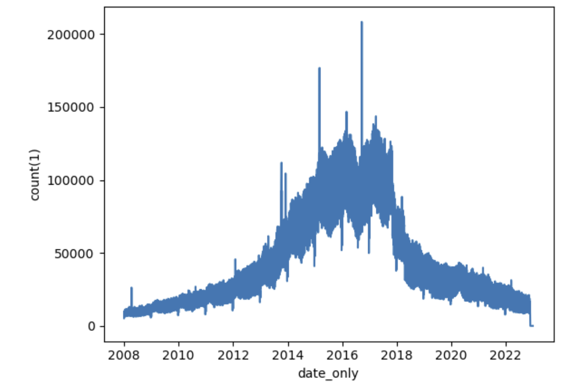
The timeline ranges from 2008 to 2022 and shows that the number of commits peak at 2016
The number of commits reaches the peak at around 2016 then dwindles down to previous levels from 2018.
In 2022, GitHub announced that they have experienced 27% growth in new developers with a 20% YoY growth in new repositories¹.
Therefore, it is interesting to note the decline in the number of commits starting from the end 2017.
Perhaps, the growth was mostly due to the contributions from private repositories or the graph suggests a data collection issue.
Throughout the timeline there are a number of sizeable spike.
Upon further inspection of the spikes that are currently being shown on figure, they considered ‘real’ events as determined by the unique messages during the specific timeframe.
Notes:
¹Github, (2022). The Global Developer Community. The State of the Octoverse. https://octoverse.github.com/2022/developer-community

Slide 7
The ‘most popular’ programming language changes throughout the years
Top 5 Programming Languages Overall | 2008 – 2011 | 2012 – 2015 | 2016 – 2019 | 2020 – 2023
JavaScript | Shell | Shell | Shell | Shell
CSS | Python | Python | HTML | Python
HTML | C | Makefile | Python | HTML
Shell | C++ | C | JavaScript | JavaScript
Python | Perl | C++ | Makefile | Makefile
Key Insights:
Found the most popular commits by taking the combining the Language and Commits table.
Shell and Python remains to be the most used languages throughout the years
C and C++ phases out throughout the years and are replaced with HTML, JavaScript and MakeFile.
Notes:
- For example: The top 5 languages in the range from 2008 to 2011 is:
- Shell
- Python
- C
- C++
- Perl
The trend changes to the languages from the ranges of 2020 to 2023
- Shell
- Python
- HTML
- JavaScript
- Makefile

Slide 8
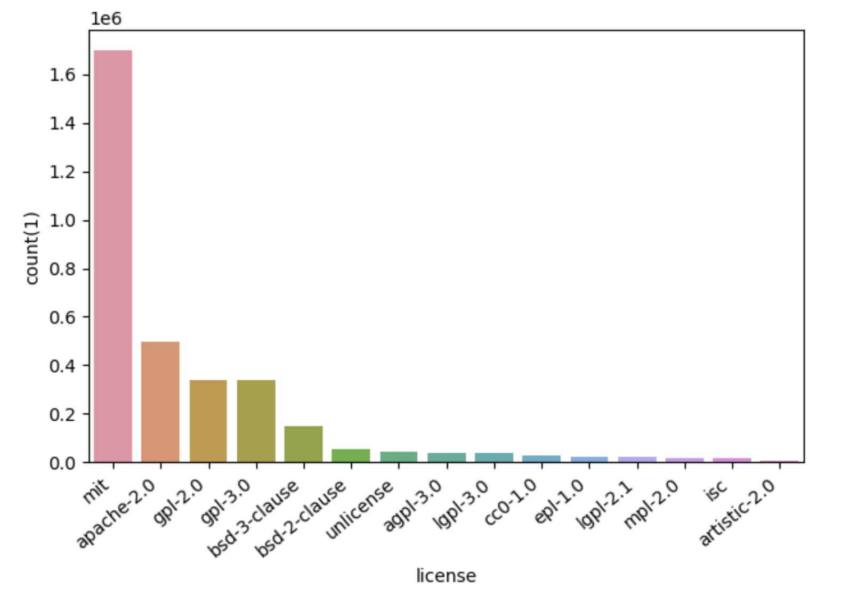
The MIT, Apache-2.0 and glp-2.0 licenses are the most used licenses
Programming Languages Associated with a License
MIT | Apache-2.0 | GPL-2.0
JavaScript | Java | Shell
CSS | JavaScript | JavaScript
HTML | HTML | CSS
Ruby | Shell | Python
Shell | CSS | C
JavaScript, Java and Shell are the languages associated with the top 3 licenses.
Different Machine Learning and AI related repositories are licensed under different licenses.
For example, the Tensorflow repository is licensed under Apache 2.0 while scikit is licensed under the BSD license.
Therefore, it is difficult to highlight any licenses that are specifically for data-science.
Notes:
- For example: The top 5 languages in the range from 2008 to 2011 is:
- Shell
- Python
- C
- C++
- Perl
The trend changes to the languages from the ranges of 2020 to 2023
- Shell
- Python
- HTML
- JavaScript
- Makefile

Slide 9
Most popular repositories are associated with Big Tech firms and hints to machine learning
Looking at the most popular repositories, there were several important repositories:
Chromium is an open-source project that aims to build a safer way to experience the web developed by Google.
CloudFoundry is similar to Kubernetes where it allows developers to build, deploy and run containerized applications
Powerpc is related to performance computing created by Apple – IBM – Motorola alliance
Most Popular Repository
Repository Name | Count
Chromium/chromium | 456581
Cloudfoundry/relint-ci-pools | 276679
Cminyard/linux | 272580
NixOS/nixpkgs | 263416
Mpe/powerpc | 243515

Slide 10
Rapidly growing repositories in 2022 have little technologies in common
The percentage increase from 2021 to 2022 was calculated to determine the fastest growing repository.
For this analysis, the year 2022 was chosen as it was thought to maximize the chance of finding more machine learning or generative AI projects.
The most notable repository in this analysis is the Google/Horologist which is Google’s opensource repository for Wear OS (smartwatch)
Upon researching the other repository names, there were not any common technologies in common with one another.
Fastest Growing Repositories in the Year 2022
Year | Repository Name | Percentage Change
2022 | Google/Horologist | 312.0
2022 | Binlidaily/binlidaily.github.io | 281.0
2022 | Stulp/dmpbbo | 238.5
2022 | Imroc/req | 151.25
2022 | Jkriege2/JKQtPlotter | 132.66

Slide 11
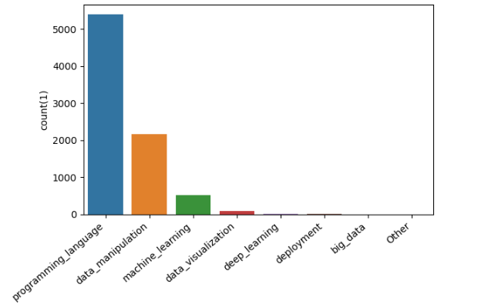
Technologies related to Data Science Projects
Methodology:
Key phrases related to data science related technologies were searched in the contents file.
The most popular data science repositories were identified to determine whether a project was a AI or ML project using the files folder.
Key Takeaways:
The most popular technology is related to Python with data manipulation technologies coming in second.
Machine Learning technologies such as TensorFlow and Keras has shown some popularity amongst the repositories
Further data collection may show that this popularity may be a signal to the rise of generative AI tools as is in the current day.
Top Technologies
Programming Language (Python, R)
Data Manipulation (Numpy, Rstudio)
Machine Learning (Scikit, TensorFlow, Keras)
Data Visualization (Seaborn, ggplot2)

Slide 12
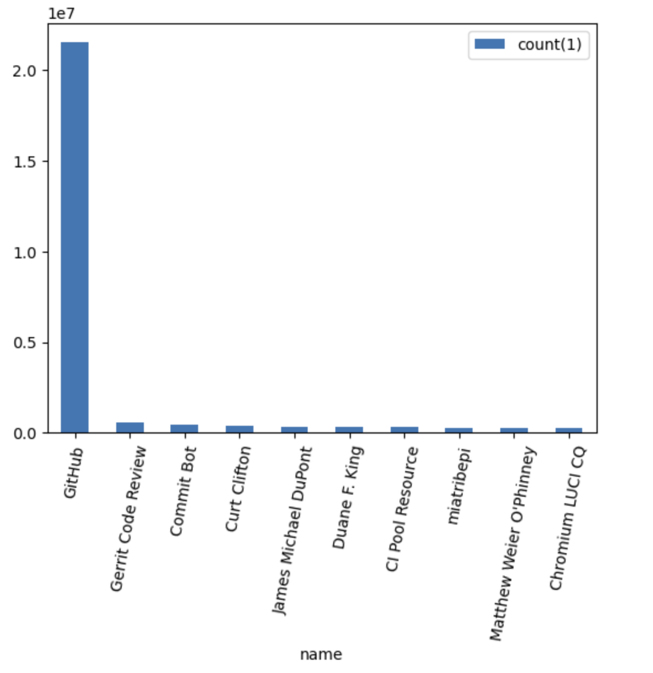
The most prolific committer are bots not associated with Big-tech
The most prolific committer is GitHub followed by Gerrit Code Review and Commit Bot.
Given that the most of the commits are coming from GitHub, it is difficult to determine whether the commits are being made from those who are associated with Big-Tech Companies.
The first human committer is Curt Clifton whose is a SwiftUI(mobile application development tool) frameworks engineer at Apple followed by James Michael DuPont who is a software developer not associated with any Big-tech companies.
The rest of the human committers are also software engineers but they do not seem to be associated with any big-tech companies.

Slide 13
Most of the known messages for committing are for fixing bugs and updates
Methodology:
The messages in the Commits column were broken up in order bucket them into their respective categories.
The table on the right represents the different buckets and the phrases which were searched.
Key Takeaways:
The most frequent known reason for committing is for bug fixes, followed closely by updates.
Although there were some messages related to technology development, it was the least popular reason for committing to GitHub.
The Other column represents the languages that did not go into any other bucket.
Common Messages | Count
Other | 150,805,707
Bug Fixes (bug fix, fix) | 36,225,403
Update (update) | 35,037,166
Branching (merge, pull, push) | 21,286,355
Commit (commit) | 8,392,974
Technology Development (artificial intelligence, machine learning, technology) | 485,578

Slide 14
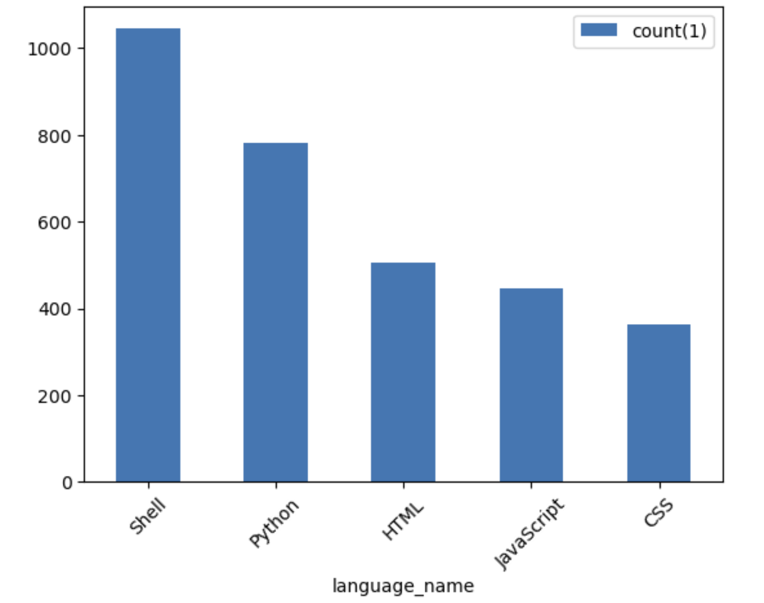
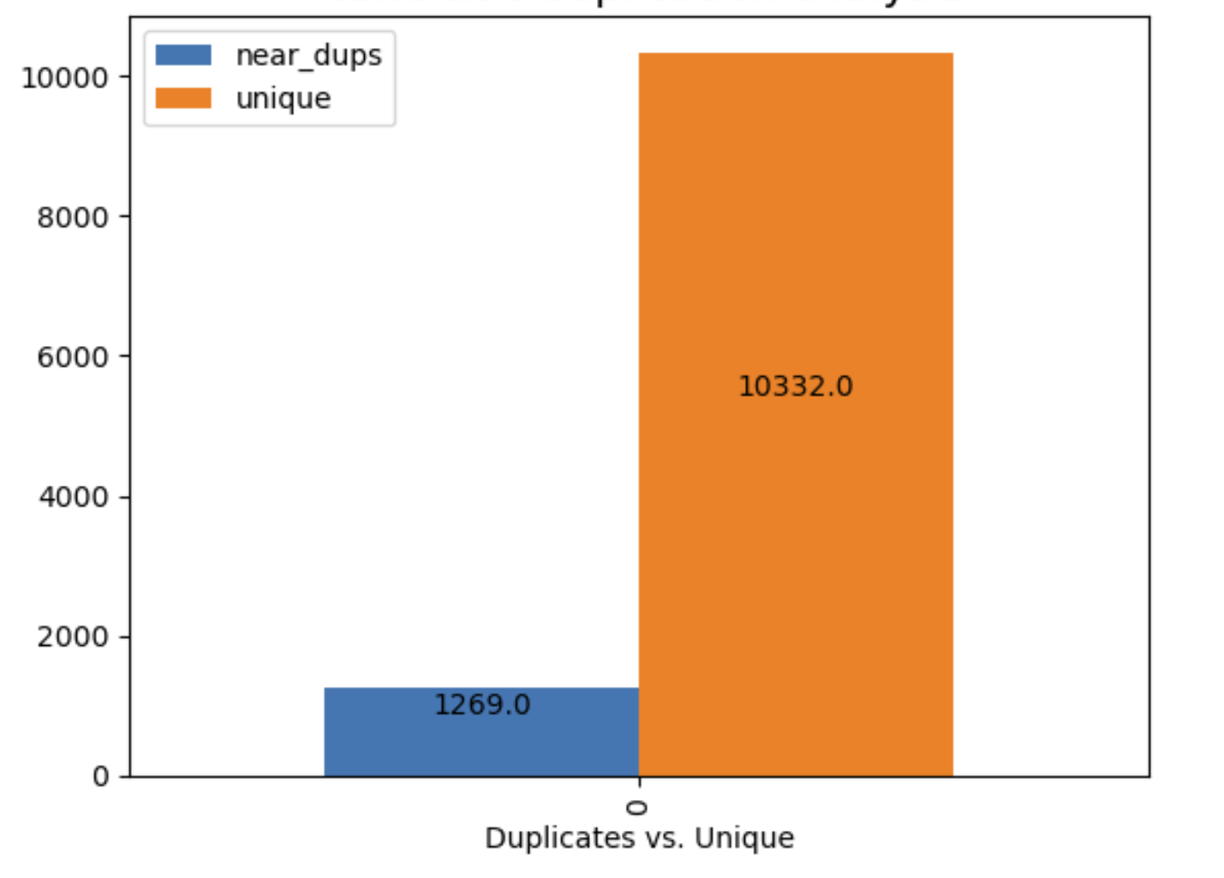
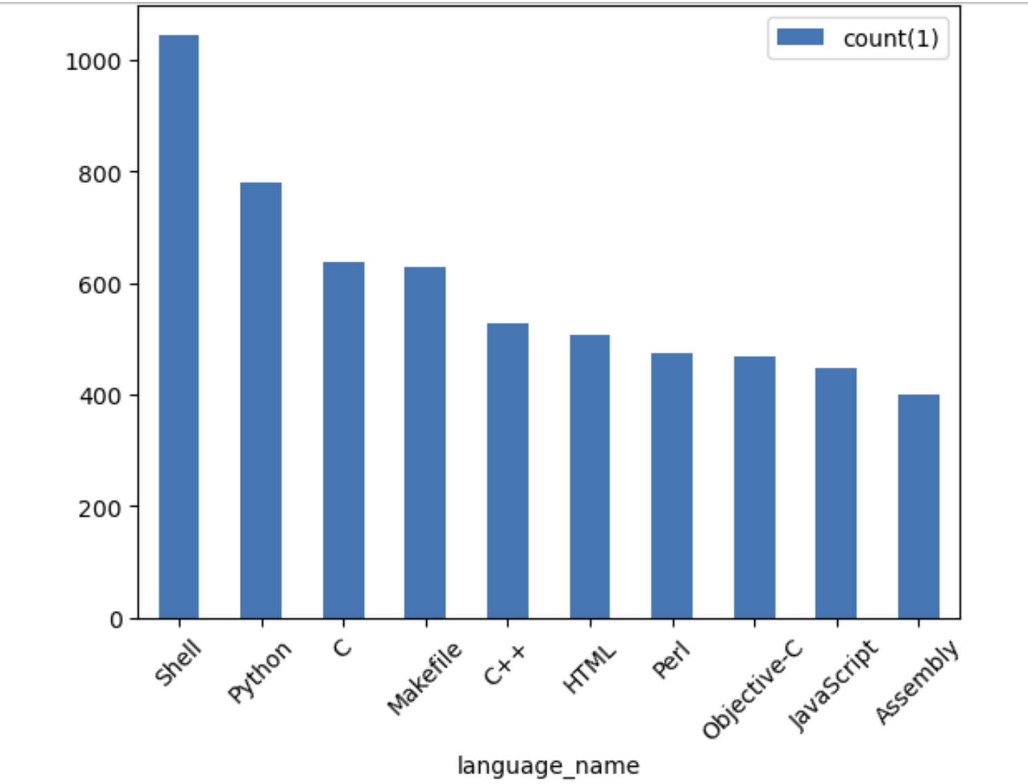
Performing MinHashLSH within subjects show that most messages are unique with Shell having the highest duplicates
Duplicated Repositories For Top 5 Programming Languages
Subject Duplication Analysis
To determine whether the subjects were duplicates, MinHashLSH was performed with a Jaccard distance of 0.3
This Jaccard Distance allows it to pickup very-similar texts which may only differ by the numbers.
By performing MinHashLSH within the subjects, it is evident that most of the subjects are unique as shown by the ~10% data that appeared to be duplicated.
Had there been a significant number of duplicates, there may be some evidence that committers are directly copy and pasting their code without much thought.
Duplicated Repositories Across All Programming Languages

Slide 15
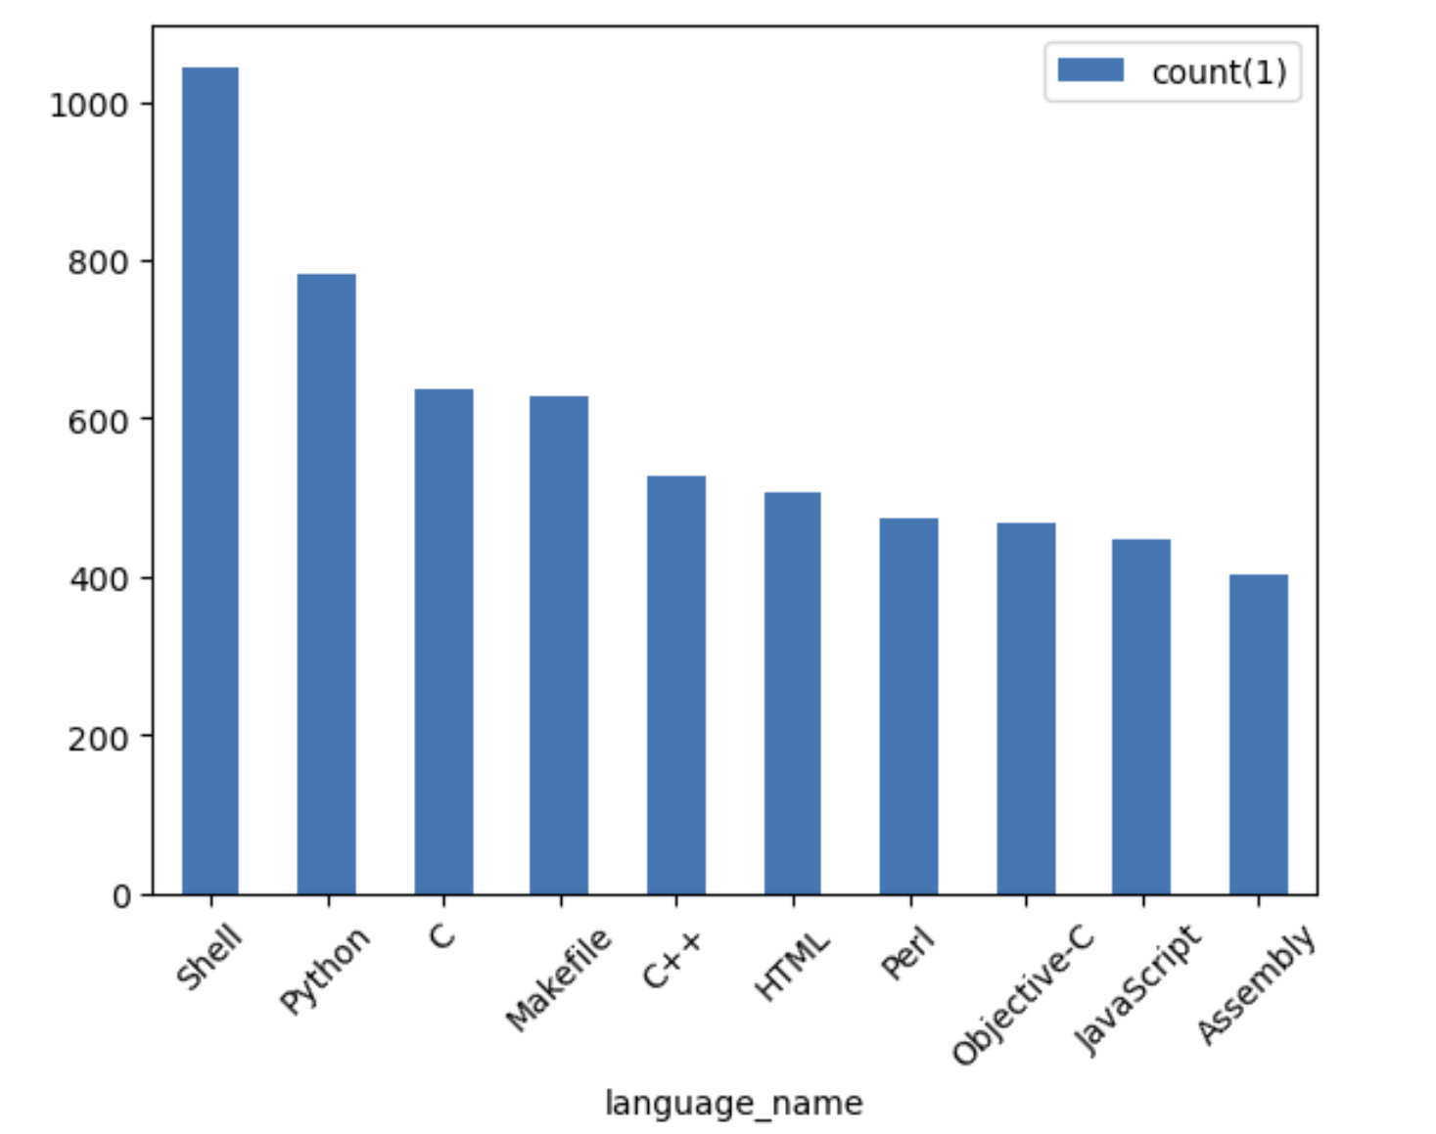
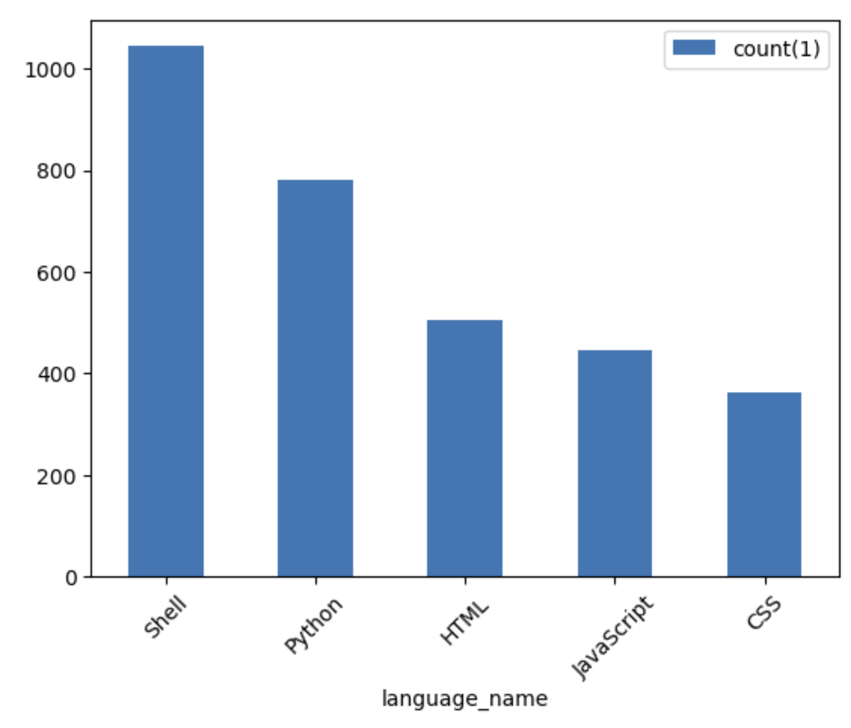
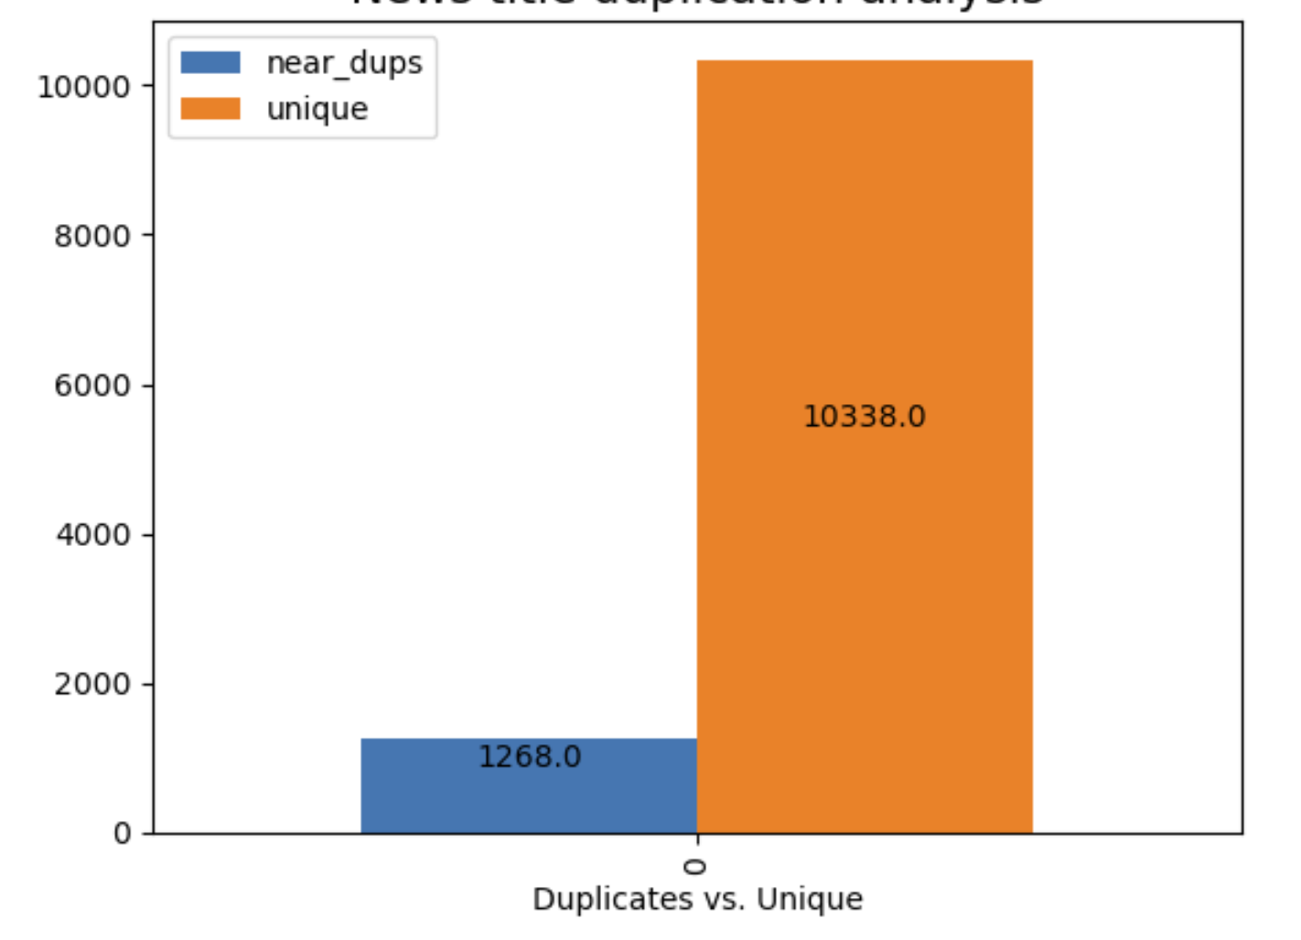
Performing MinHashLSH on messages yields similar outputs to performing MinHashLSH on subjects
Duplicated Repositories Across All Programming Languages
Duplicated Repositories Across Top 5 Programming Languages
Message Duplication Analysis

Slide 16
Conclusions and Actionable Recommendations
Looking at the timeline, there is a significant decrease in the number of commits starting from 2018.
There are some trends which hint to the popularity of AI
Python is one of the most popular languages throughout the years
Tools like PyTorch, Keras, and other machine learning tools have been increasing in popularity.
Popular repositories are ones related to the tools which one might use on a machine learning project.
Despite these trends, human generated unique messages alongside the lack of Gen-AI related repositories seem to suggest that it is still too early to determine whether or not Generative AI will take over software engineers.
Based on the findings above, more data needs to be collected to continue tracking the popularity of Generative AI and its impact on the efficiency of Software Engineers.
To have a more complete picture, one should continue mining the publicly available GitHub repository dataset to collect sufficient amount of data, focusing on the years of 2022 and 2023 (given that these are the years when TuringBots and Generative AI started to rise).
In addition, one could look into applications which compare the written code with AI Generated Code to determine the detect whether the code is written by Gen AI. Then, there would be a more accurate representation of the impact that TuringBots have on software engineers.

